Slide 1
HandFont Pro: The Future of Fonts, Crafted from Your Own Handwriting Images.
Avdhesh Kumar Sharma
2K21CSUNO4008
Btech CSE AIML-5A
Unnati Verma
2K21CSUN01098
BTech CSE- 5B

Slide 2
About the Problem Statement
Nowadays, being able to use our own handwriting on the computer is important.
But the current way of doing this through font creation websites is not easy.
These websites make us put in each letter one by one, which takes a lot of time and effort.
This makes it hard for people to add their special touch to their digital writing.

Slide 3
Origin of the Problem Statement
Students have a tons of assignments and tasks to do on daily basis which is highly tiring work.
They don't have much time to spend on their skills leads to inadequate learners.
And if they use online websites they can't make their digital work feel like it's really from them.
We need a simpler and faster way for students to use their handwriting in their digital work.

Slide 4

Scope of the Project :-
Eliminating the manual input of individual letters, with a focus on aiding students in doing assignments efficiently.
Prioritize user experience, performance optimization, and scalability in system design.
Also, consider applications for official government documents, ensuring compliance with relevant standards and regulations.

Slide 5
System Architecture/ Methodology

Slide 6


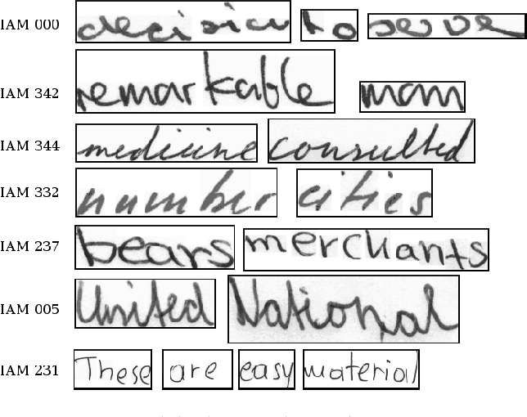
-Data Acquisition
iam dataset
For the Initial training of the recognizing model we have taken the dataset from kaggle repository , the name of this dataset is IAM Handwriting Database 3.0. -Over 650 people contributed their handwriting
-Over 1500 scanned documents containing the handwriting
-115'320 isolated and labeled words

Slide 7
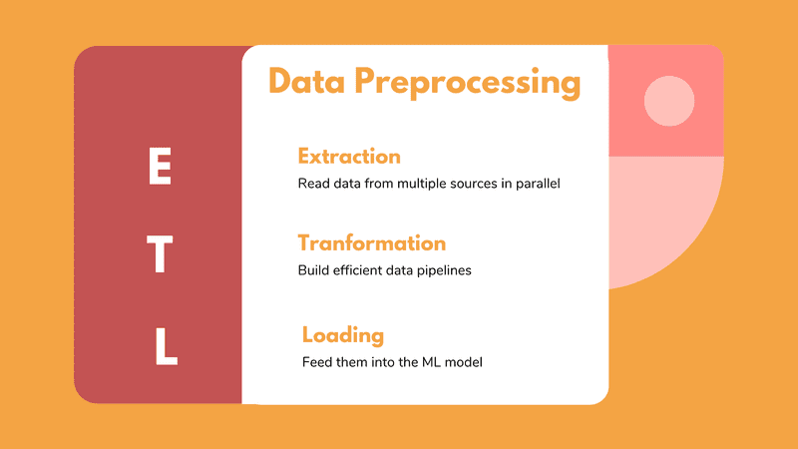


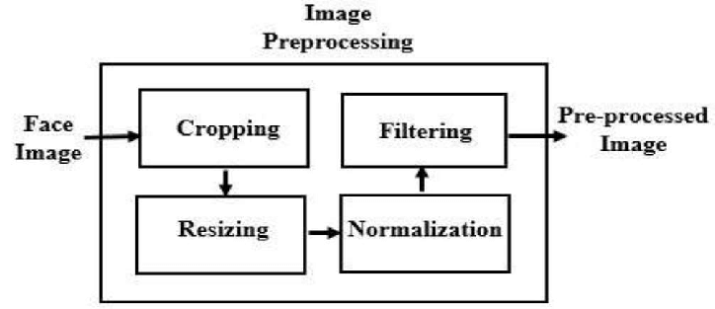
-Data Preprocessing

Slide 8

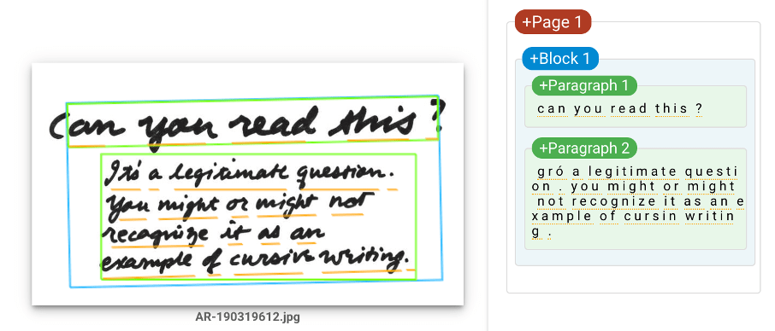
-Handwriting Recognition Model
Using the Cnn model with the segmentation words techniques we are able to make the recognize the words from handwriting to the text.
We also use the google recognizer library which inherits all the techniques itself and can do the same thing mentioned above.

Slide 9
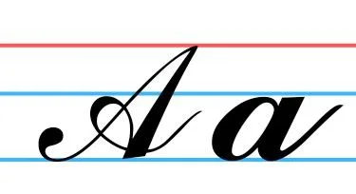
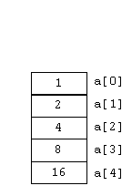

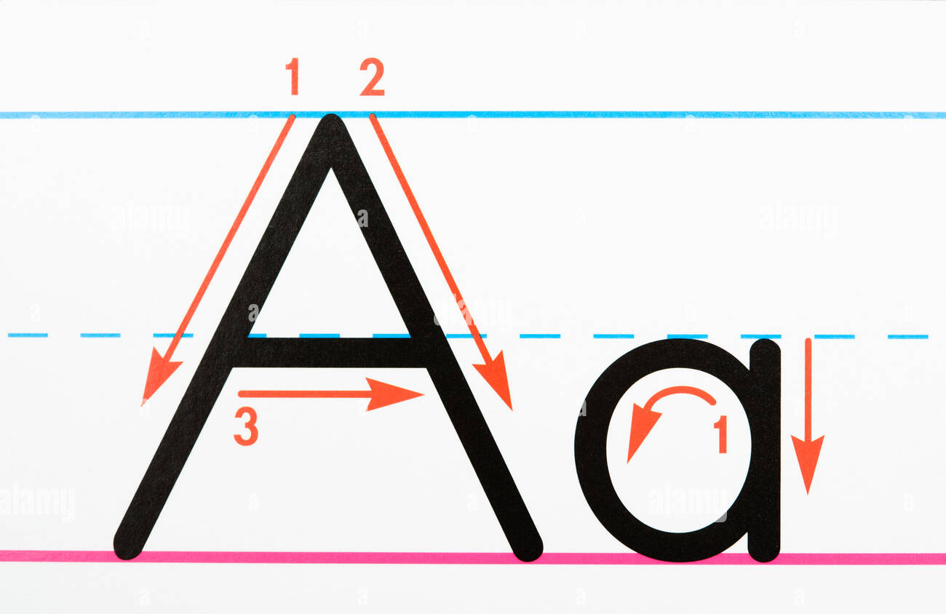
-Mapping Technique
By making another segmentation algorithm in order to extract each character then classifying them , by making this we are comparing an array of handwriting character .
Then we can just map the array to the original alphabet.

Slide 10
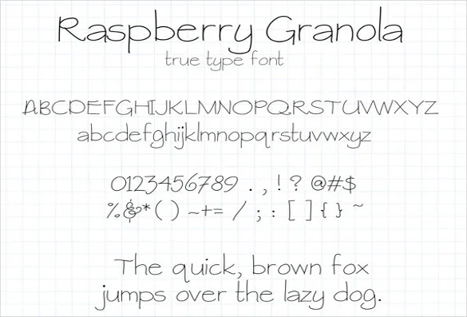
-FontForge Like Font Mapping
Font Forage is the one of the best library we can use to make the font manually , but here we are trying to get the effect like font forage.
We already mapped the characters , Example -we only did 15 characters mapping only , but we are using a default mapping in the starting so , when we encounter the character again it will find the best among them and replace them then .
So as the user upload again and again the accuracy will continue to increase.

Slide 11
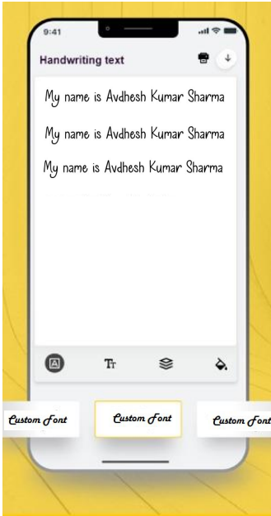
-Prototype Application Interface:
Simple and user-friendly design for easy navigation.
Intuitive input options for uploading handwritten samples.
Preview section for visualizing generated digital fonts.
User controls for customization and fine-tuning of fonts.

Slide 12
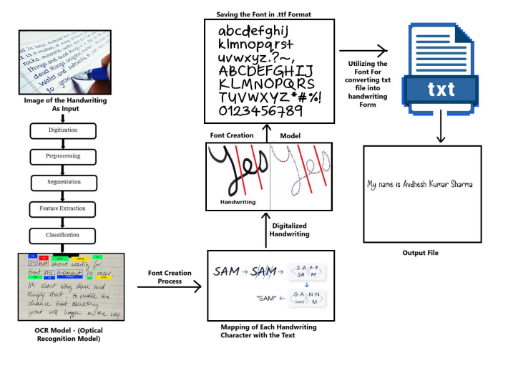
FlowChart :-

Slide 13

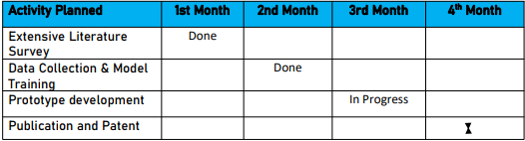
-TimeLine of this Project

Slide 14


Future Enhancement :
-Multi-Language Support
-Enhanced User Customization
-Feedback Loop and User Training
-Mathematical Integration

Slide 15
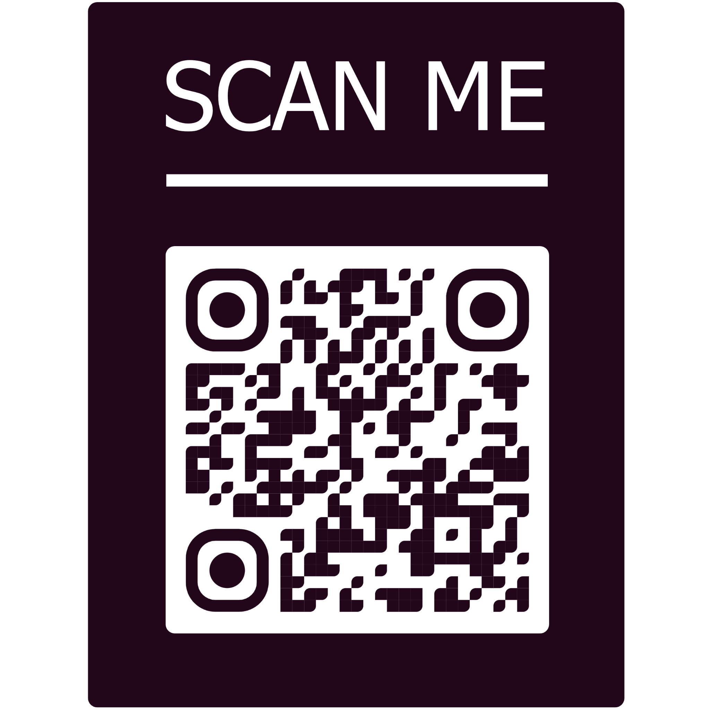
QR CODE

